Slide 1
Positive Ageing ;Myths and challenges
By
Rekhasree K.R
Asst.Prof of Sociology
NSS College ,Pandalam

Slide 2
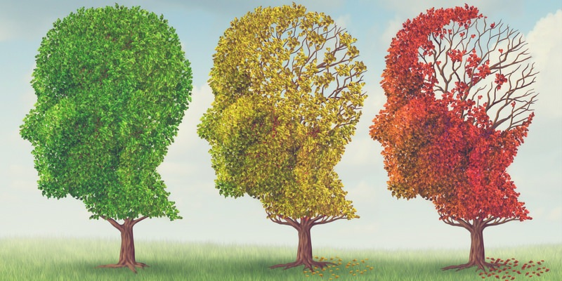
ageing

Slide 3
Introduction
Ageing is a pervasive global phenomenon that affects individuals at different rates
It starts from birth and continues till death
Ageing can therefore be perceived either as a part of Developmental Process (changes in the life stages Infancy –adulthood--aged)
Or
It could be also perceived as a Social Problem (role changes/conflicts/abuses/ dys-functionality/ loneliness, despondency/depression)
Our approach and attitude towards this social construct determines ‘ Ageing to be either as a Positive or Negative process’

Slide 4
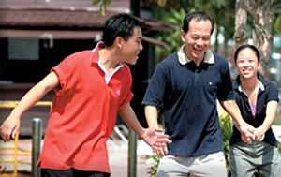
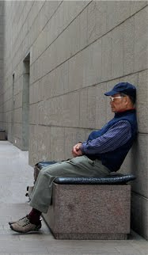
Positive Negative

Slide 5
Types of Ageing
Biological/Physiological Ageing
Psychological Ageing
Socio cultural Ageing
Positive Ageing/Productive Ageing/Successful Ageing/Healthy Ageing/Active Ageing
Negative Ageing
explicit signs of rage ,resistance and renunciation

Slide 6
Ageing can thus Progress to..
Ageing with Disabilities (Partial Dependency)
Ageing towards disabilities ( Total Dependency)
Absent Body Ageing Phenomena ( simultaneous presence and absence of ageing)

Slide 7
The Discipline
The branch of study focusing on these different aspects of ageing –Social Gerontology
Three Constructs are focused (Age/Ageing /Aged )
The approach is directed at three levels
Individual/Social and Societal Level

Slide 8
Focus
Is to understand the various myths and realities of ageing phenomenon based on secondary sources of data
To have a better understanding on the impact of various coping strategies employed by the aged and ageing individuals in making the experience of ageing a healthy and successful one

Slide 9
Myths about Old Age
It makes you crippled due to physical problems
It makes you role-less due to deteriorating financial insecurity
It makes you invalid /powerless in decision making
It makes you an economic/social burden for others
It makes you isolated /lonely/negative

Slide 10
Reality..
Every older Person is different
Physical age though at 60…functional age could be that of 30
For some physical age may be 40 …but the functional age will be that of 75
Thus ageing experiences differ with age and individual…this is probably because of the approach/attitude towards life style or to the ageing process itself

Slide 11
attitudes towards the elders
Ageism: Old age is viewed negatively, thus elders are considered a subject of jokes.
Ageism has negative consequences not only on elders, but on individuals, families, groups and community levels

Slide 12
Consequences of Ageism
Not valuing the opinions, contributions and ideas of the elders.
Treating the elders with disrespect.
Physical care, verbal and nonverbal behaviors exhibited toward them are colored by the beliefs held about them.
Ageism can lower or destroy the self-esteem of elders.
Limit the degree to which elder’s problems are worked up and managed by health professionals.
The elders become dependent and unacceptable
Lead to a variety of abusive behaviors about elders.

Slide 13
What is Positive ageing???
Positive ageing is a concept promoted by world health Organisation in the year 2015
Positive aging means…..
1) Supporting people of all ages to achieve their full potential, 2) Respecting older adults’ engagement in economic, social, cultural, and family life. 3) Fostering better solidarity between generations 4) Creating a society where equality, independence, participation, care, self-actualisation, and dignity of all people are the prime objectives.

Slide 14
How to mitigate this paradox? Through strategies
Proper care at the individual, social and societal level
Instilling Positive attitude-positive feedback
Selection and Optimization of goals
Target adapted model
Cumulative Advantage and disadvantage model

Slide 15
Threats faced at different levels
Personal level-
(threats –health and abilities, financial resources, life experiences, Perspectives)
Social level
(threats in direct role of social relationships through disengagement , Indirect role of social networks through avoidance)
Societal level
(Formal care service sources availability ,service qualities, community participation chances given and not given)

Slide 16
Coping Mechanisms
Maintain health through diet and Exercise (keep Going)
Be optimistic (Self affirmation-adaptation)
Avoid Negative situations (Keeping stable, Keeping balance)
Be more engaged in hobbies that interest you (Continuity- ‘staying Me’ )
Take control of age related behavioural changes (‘Stay Calm’)
Be more relaxed
(Brandtstadter and Greve(1994)

Slide 17
Coping Strategies to preserve Self
Assimilation
(Awakening of Oneself to the reality of life)
Accommodation
(Try to accommodate to the resources available for a healthy existence)
Immunization
(Identity management strategies while defending against threats to his positive Self )
Readjustment
(A well balanced Personality)
( Chairmaz -1983)

Slide 18
10 Ways to Activate Positive Aging in Your Life
Stay physically active
Exercise your brain
Adopt a healthy lifestyle
Stay connected to other people
Create positive emotions for yourself
Don’t sweat the small stuff
Set yourself goals and take control
Minimise life stress
Have regular medical check–ups
It is never too late to start one of these behaviours.

Slide 19
The Consequence…
Overall physical ,mental ,social and spiritual wellbeing
Minimized disability
Increased longevity
Decreased morbidity
Improved physical and mental function
Enhanced quality of life

Slide 20
Leading to..
A problem free, relaxed and peaceful life which would be..
A Healthy , Successful , Active, Productive and a very Positive Life
“Age is all a matter of Mind …if you don’t mind it never matters …” (Mark Twain)

Slide 21
THANK YOU

